Slide 1
Discussion 3 - Recursion + Tree Recursion
Chris Allsman
Section 120

Slide 2
Administrivia
CSM adjunct sections open for signups - see Piazza, sign up by tonight
Will be having lab next week
HW3 out, due next Thurs
Start early!
Hog contest released, optional
Due 2/22

Slide 3
Midterm
Y’all did great and are gonna be fine!
This is meant to indicate how you are doing - so if you didn’t do as well as you wanted, you should think of what to change
links.cs61a.org/chris-checkins

Slide 4
1) Abstraction

Slide 5
What is Abstraction?
The separation of implementation and use
Use - how do we, as humans, interact with this thing?
Implementation - how does this thing work?

Slide 6
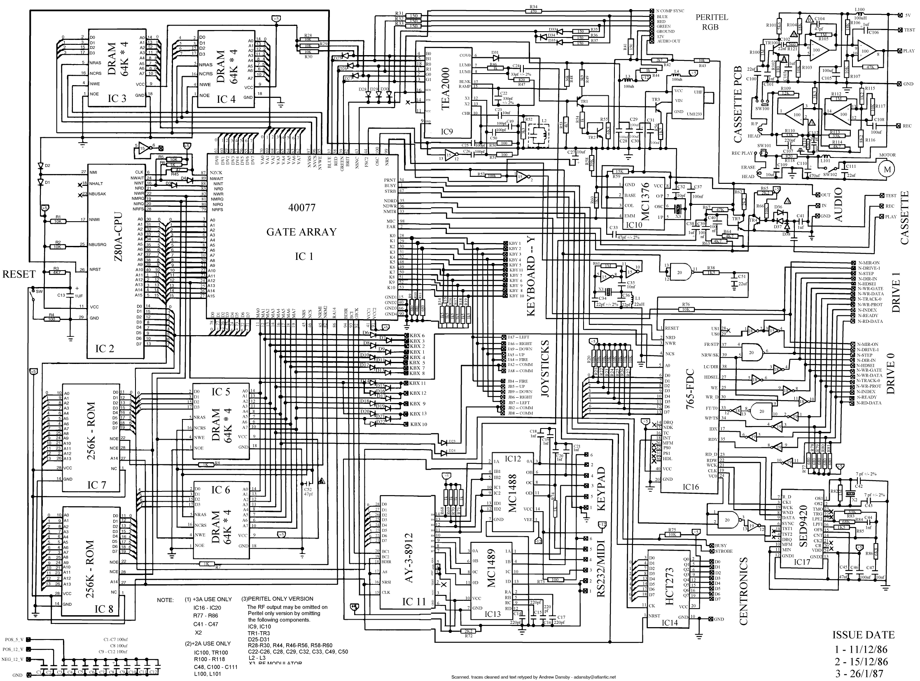

Abstraction Example
Implementation
Use

Slide 7
Abstraction Practically
You’ve already encountered abstraction
Example: print(5)
Print is a function but
How does it actually display 5?
How does it know what to display?
What is the body of print?
You don’t need to know!

Slide 8
Abstraction and Functions
Have been concerned with the implementation of functions
The use of functions is just as important!
A function, f(x), does two things:
Take in a value in its domain
Spits out a value in its range

Slide 9
Abstraction and Functions
Function Body
(Abstracted Away)
Input (Arguments)
Output (Return Value)

Slide 10
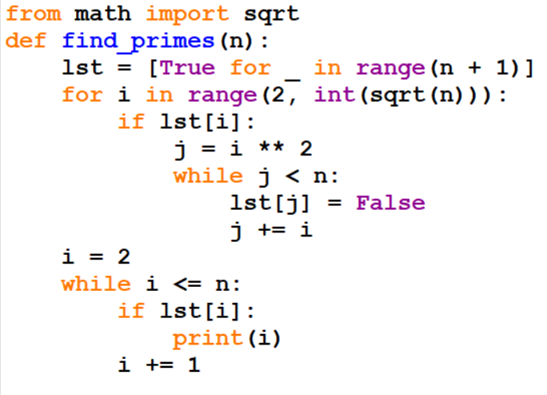
Function Abstraction Example

Slide 11
Abstraction and Functions
Find Primes
Input (Integer n)
Output (Prints all primes from 2 to n, returns None)

Slide 12
Recursion
Base Case
What input will you need to do no computation for
A way to shrink the problem
Get 1 step closer to base case
Ex: remove digit, subtract one, slice list
A way to combine your sub-problem from 2) and your overall problem

Slide 13
Example
def fact(n):
if n <= 1:
return 1
else:
return n * fact(n - 1)

Slide 14
Example
def fact(n):
if n <= 1:
return 1
else:
return n * fact(n - 1)
Base case: 1! defined as 1

Slide 15
Example
Hint: think about your base case as if that was your very first call
def fact(n):
if n <= 1:
return 1
else:
return n * fact(n - 1)
Base case: 1! defined as 1

Slide 16
Example
def fact(n):
if n <= 1:
return 1
else:
return n * fact(n - 1)
To get one step closer: subtract 1 from n

Slide 17
Example
def fact(n):
if n <= 1:
return 1
else:
return n * fact(n - 1)
What does this mean, exactly?

Slide 18
Back to Functional Abstraction
What does fact(n) “mean”?
n!
What does fact(n - 1) “mean”?
(n - 1)!
Imagine fact(n - 1) returns (n - 1)!
n! = n * (n - 1)!. Just have to multiply that result by n.

Slide 19
Example
def fact(n):
if n <= 1:
return 1
else:
return n * fact(n - 1)
n * (n - 1)! = n!

Slide 20
Recursion
Base Case
What input will you need to do no computation for
A way to shrink the problem
Get 1 step closer to base case
Ex: remove digit, subtract one, slice list
A way to combine your sub-problem from 2) and your overall problem

Slide 21
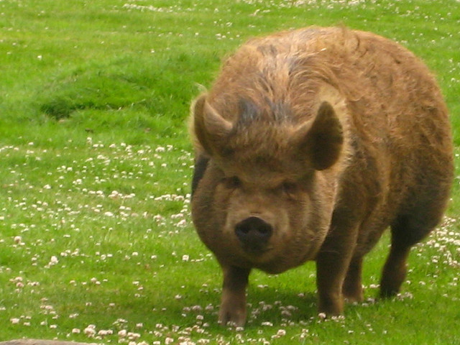
Attendance!
links.cs61a.org/chris-disc
Magic Word: heart

